Slide 1



Quantum-Walk–Based Entanglement Distribution in Quantum Networks
Soumyojyoti Dutta
M.Tech, Quantum Technology
Supervisor: Dr. Chandan Datta
Department of IDrd, IIT Jodhpur

Slide 2
Motivation
Long-distance quantum communication is limited by noise and decoherence.
Quantum repeaters are essential for extending entanglement, but current ones work mostly with two level quantum systems.
High-dimensional entangled states (qudits) offer increased capacity, better resistance to noise, and richer correlations.
Need scalable, robust methods for entanglement distribution over arbitrary topologies.

Slide 3
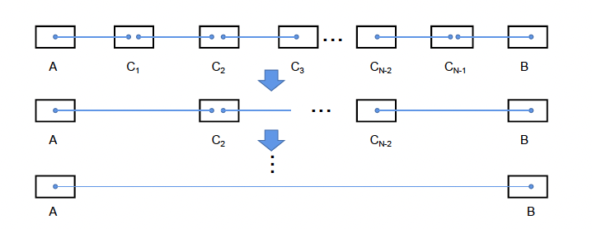
Problem Statement
Most entanglement distribution protocols rely on Bell or GHZ measurements, which are experimentally hard in high dimensions.
Entanglement tends to decay exponentially over distance without repeaters.
Standard repeaters aren't well-suited for high-dimensional or multi-party systems.
How to create a generalized framework that works with d-dimensional states using only local operations?

Slide 4
Key Idea of the Paper
Use discrete-time quantum walks (DTQWs) with coin operators to propagate entanglement.
Modular construction: distribute entanglement using Bell or GHZ states as basic building blocks.
Avoid global Bell/GHZ measurements by performing local quantum walk-based fusion.
Apply to arbitrary network topologies using graph-based methods (e.g. Steiner tree).

Slide 5
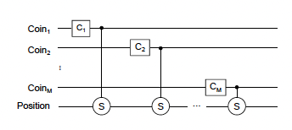
Quantum Walk Model
Hilbert space: Position space ⊗ Coin space(s).
Shift operator: Controlled operation moving walker based on coin state.
Coin operator: Can be Fourier transform or Hadamard-type gates.
Multi-coin model allows flexibility in fusing multiple states.

Slide 6
Key Modules Introduced
Bell-to-Bell Swapping: Merge two Bell pairs into one between distant nodes.
GHZ Fusion: Two GHZ states → one larger GHZ using local walk.
Single-coin and multi-coin models depending on network complexity.
Measurements + local recovery operations → high-dimensional GHZ.

Slide 7
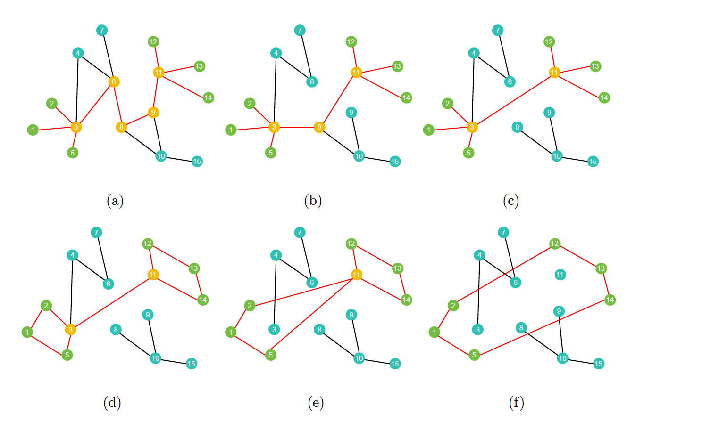
Distribution over Arbitrary Networks
Problem: How to minimize resource overhead?
Use Steiner tree to connect target nodes with minimal extra links.
Level-based GHZ propagation from root to leaves.
All operations are local to nodes – no need for long-range gates.

Slide 8
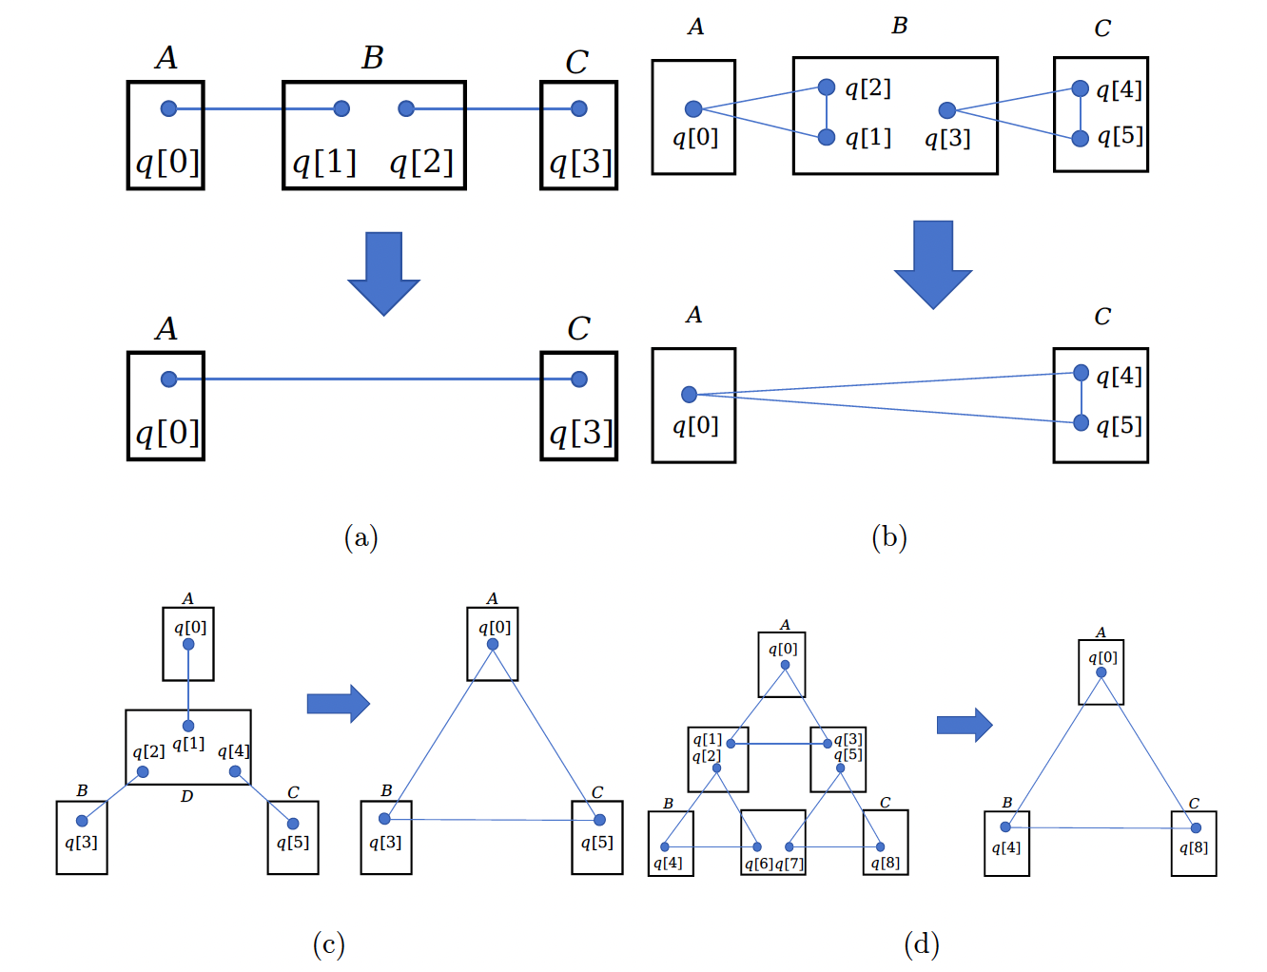
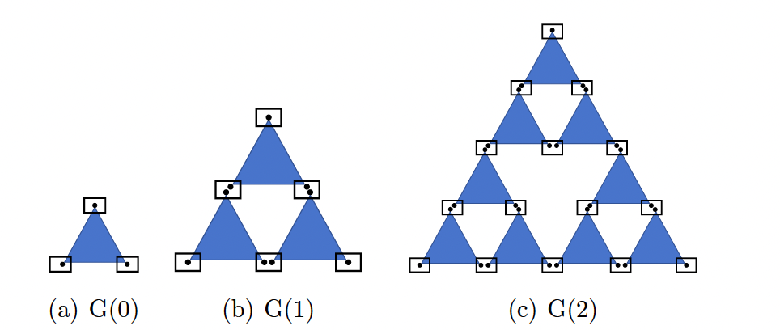
Quantum Fractal Network Example
Inspired by Sierpinski gasket structure.
Constructed a scalable fractal using repeated GHZ state fusion.
Local operations fuse small GHZ triangles into larger ones.
Demonstrated wider quantum walk spread vs traditional fractals.

Slide 9
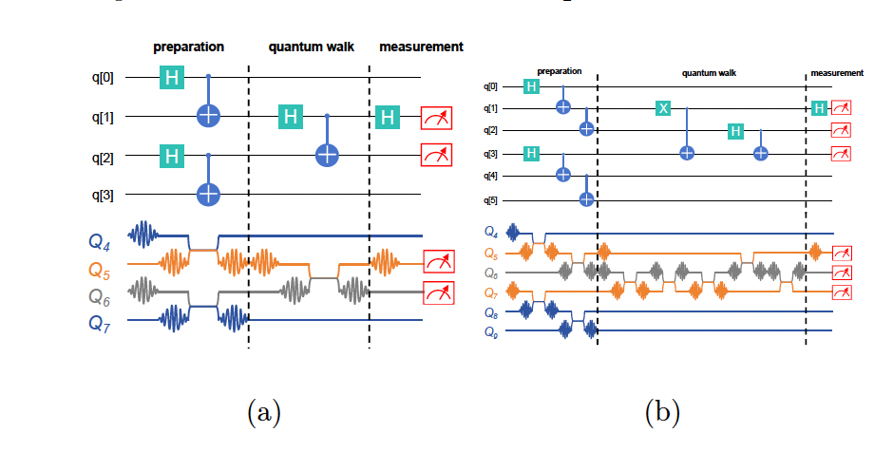
Experimental Implementation
Performed 5 experiments on 10-qubit superconducting processor.
Configurations:
  Two Bell states → new Bell.
  Two GHZ → new GHZ (two methods).
  Three Bell → GHZ.
  Three GHZ → GHZ.
Fidelity:
  Bell: ~80–90%.
  GHZ: ~50–55%.

Slide 10
Summary of Contributions
First to implement quantum walk-based entanglement distribution.
Framework supports arbitrary dimensionality and node numbers.
Uses only local operations, no global measurement.
Validated with superconducting hardware.

Slide 11
Research Direction 1 – Continuous-Time Quantum Walks
CTQWs require no coin register – simpler physical implementation.
Direct evolution under network Hamiltonian.
Potentially more stable under decoherence.
Explore how CTQWs can replicate or extend DTQW-based repeater modules.

Slide 12
Research Direction 2 – Variational Coin Operators (QNN-style)
Treat coin unitary as a variational circuit with tunable parameters.
Optimize to maximize fidelity of final entangled state.
Combine with classical optimizer (gradient descent, RL, etc).
Inspired by variational quantum algorithms (VQAs), can adapt to noise and topology.

Slide 13
Research Direction 3 – Entanglement Routing via Quantum Reinforcement Learning (QRL)
Move from "distribution" to "routing" – optimize paths dynamically.
Use QRL or classical RL to learn best path and swap sequences.
Prior work (e.g. QuDQN) improved throughput and latency.
Combine routing with walk-based fusion methods for adaptive, scalable protocols.

Slide 14
Conclusion
Paper establishes a promising new approach to scalable entanglement distribution.
My research will explore three directions:
CTQW as a simpler, possibly more robust alternative.
Adaptive entanglement generation via learnable coin operators.
Intelligent entanglement routing with QRL.
Together, these address current gaps and move toward practical quantum networks.

Slide 15

THANK YOU

